Slide 1

Introduction to Natural Language Processing
(Slides adapted from some by ) Nathan Duran
Notes:
Abstract:
Natural language is highly complex. A word may have different meanings depending on its context and subtle grammatical differences may utterly change the meaning of a sentence. Yet, in computing terms, language representation is often nothing more than a string of characters - a sequence of bytes - which are not able to express the rich and complex syntax and semantics of human languages.
New Natural Language Processing (NLP) and Deep Learning techniques are able to generate representations of words, sentences or documents, which do capture their meaning. Word embedding’s, can model the similarity and relationship between words and sentences, and larger language models, such as BERT, ELMo and GP2, facilitate Natural Language Understanding (NLG) tasks and may even be used to generate text.
We will explore how these techniques and deep learning architectures work and how they have been successfully applied to many classic NLP tasks such as language translation, question answering, text classification and language generation.

Slide 2
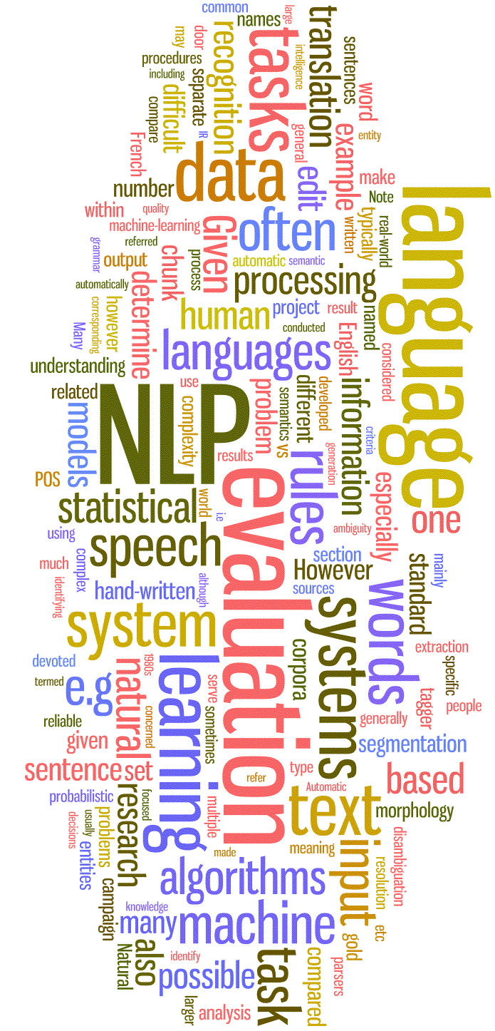
Intro to NLP, solved problems
Introduction to Natural Language Processing
What is it and why it is hard?
Tasks and applications
SOTA examples
Tools and libraries

Slide 3

What is Natural Language Processing?
Natural Language Processing (NLP) incorporates the fields of Linguistics, Statistics, Computer Science and AI.
How machines process, analyse, derive meaning from, generate or communicate with natural language.
Understanding and emulating human communication – considered one of the core objectives of AI.
Turing's ‘Computing Machinery and Intelligence’, i.e. the Turing Test is probably the earliest and most famous example.
Turing, A. M. (1950) ‘Computing Machinery and Intelligence’, Computing Machinery and Intelligence. Mind, 49, pp. 433–460.

Slide 4

What is Natural Language Processing?
Symbolic or rule-based - focuses on encoding rules and language in mathematical logics. But it turns out this is hard!
Languages change
Not all languages are the same
Combinatorial problems - scaling
Statistical and probabilistic – empirical distribution of language.
Account for variation of language - time/communities
Do not need rigid ‘rules’
Handle ambiguity
Machine learning NLP is rooted in the latter approach and often surpasses traditional probabilistic methods.
https://xkcd.com/1838/

Slide 5
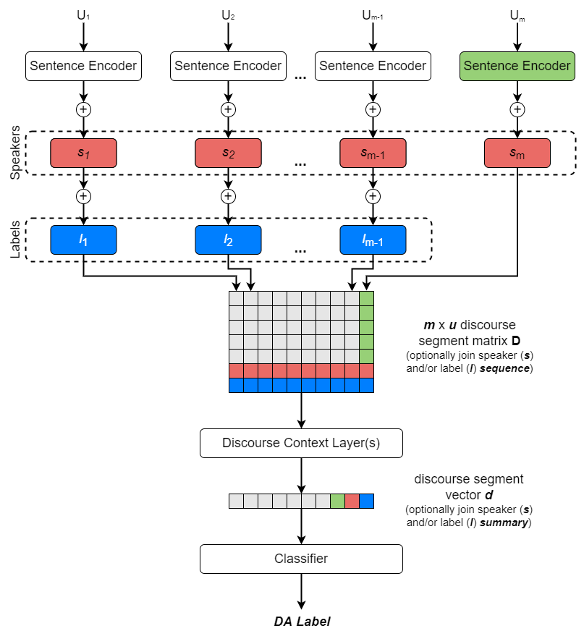
3 NLP Themes: 1 Learning and Knowledge
Words compose to form sentences, sentences compose to form dialogues. Result: a hierarchical dialogue classifier.
The two major paradigms in NLP, symbolic and statistical, can be also be framed as:
Linguistic structures that are general-purpose and derived from knowledge of language.
End-to-end systems that are purely data-driven ML models which, once trained, produce the desired output in a ‘black box’ fashion.
In practice, linguistic knowledge (or more broadly world knowledge) often informs the ML approach and influences or inspires the architecture.

Slide 6
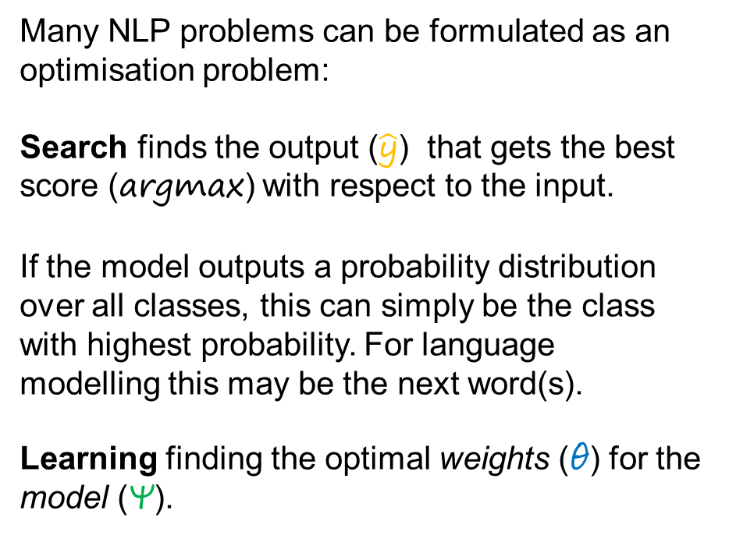
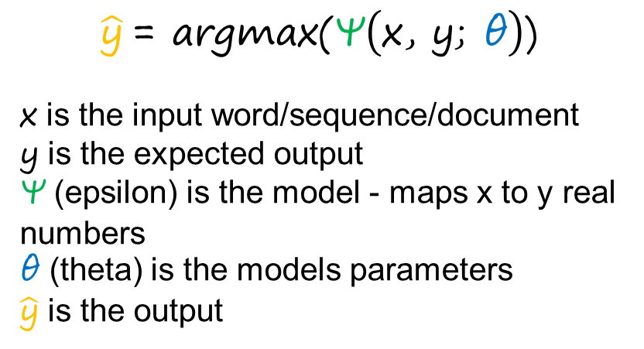
3 NLP Themes: 2 Search and Learning
Many NLP problems can be formulated as an optimisation problem:
Search finds the output ($\hat{\text{y}}$) that gets the best score (argmax) with respect to the input.
If the model outputs a probability distribution over all classes, this can simply be the class with highest probability. For language modelling this may be the next word(s).
Learning finding the optimal weights (θ) for the model (Ψ).
$$\hat{\text{y}} \text{= }\text{argmax}\text{(}\text{Ψ}\left(\text{x}\text{, }\text{y}\text{; }\text{θ}\right)\text{)}$$
x is the input word/sequence/document
y is the expected output
Ψ (epsilon) is the model - maps x to y real numbers
θ (theta) is the models parameters
$\hat{\text{y}}$ is the output

Slide 7
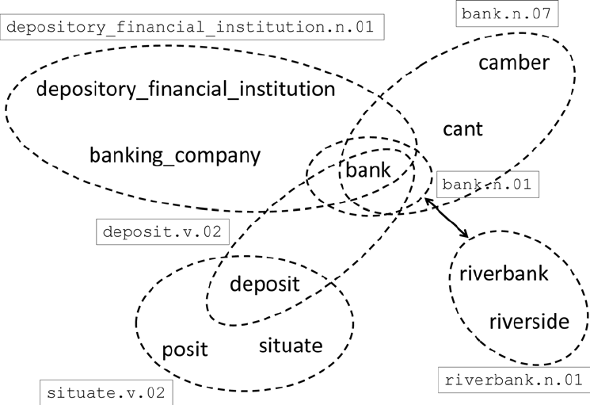
3 NLP Themes: 3 Relation, Composition and Distribution
Relational - refers to relationships between entities that can be represented in an ontology. E.g. a Banker is a profession and works in a Bank, which deals with Money.
Compositionality - small units compose to represent more complex meaning. E.g. word-parts to form words, then words form sentences and sentences into paragraphs, etc.
Distributional - the context within which words appear, based on the distribution. This can often change their meaning, or in some cases define the word. E.g. Bank → company or river.
https://wordnet.princeton.edu/

Slide 8
Why is it hard?
An early attempt (1950s) at translating a biblical sentence from English to Russian and back again.
“The spirit is willing, but the flesh is weak.”
Resulted in…
“The vodka is good, but the meat is rotten.”
Prosody – Emphasis and/or punctuation changing the meaning.
“You know. I don’t.” [So don’t ask me.]
“You know. I don’t.” [Actually, I really don’t.]
“You know I don’t.” [You know that I don’t.]
Anaphora – A word referring back to another word used earlier in a text or conversation.
“Alice went shopping after work and then she went home.”
https://en.wikipedia.org/wiki/Georgetown%E2%80%93IBM_experiment
Notes:
Examples of:
Different word meanings – depending on context.
Subtle differences with change of emphasis/grammar.
Using previous knowledge to interpret words.

Slide 9
Why is it hard?
Ambiguity
Hospitals are sued by 7 Foot Doctors
Local high school dropouts cut in half
Idioms
Dark horse
Get cold feet
World Knowledge
Mary and Bob are siblings.
Mary and Bob are parents.
Non-standard English
Txt spk – SMH, OMG
Tweets @the_usr and #anything
Emoji 📌😎🤯🦄🧩
Tricky Names
IT is a great movie…
Let It Be was recorded…
Notes:
Examples of:
Different word meanings – depending on context.
Subtle differences with change of emphasis/grammar.
Using previous knowledge to interpret words.

Slide 10
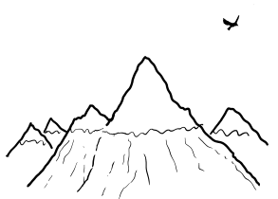
Twitter Bird - XKCD
A bird pecking a mountain once every 1000 years and removing a few specs of dust.
The time taken to flatten the mountain = 1 eternal day.
It would take 10,000 eternal years to read all the tweets…
Tweets are 140 characters long. There are 26 letters in English - 27 including spaces.
So, there are 27¹⁴⁰ ≈ 10²⁰⁰ possible strings.
Claude Shannon determined there is ~ 1.1 bits of information per letter of written English. So, there are 2^{140×1.1} ≈ 2×10⁴⁶ meaningfully different English tweets.
Reading 2×10⁴⁶ tweets would take a person ~ 10⁴⁷ seconds or…
3,170,979,198,376,458,650,431,253 billion years!
https://what-if.xkcd.com/34/
Notes:
Randall Munroe – XKCD ‘What if?’

Slide 11
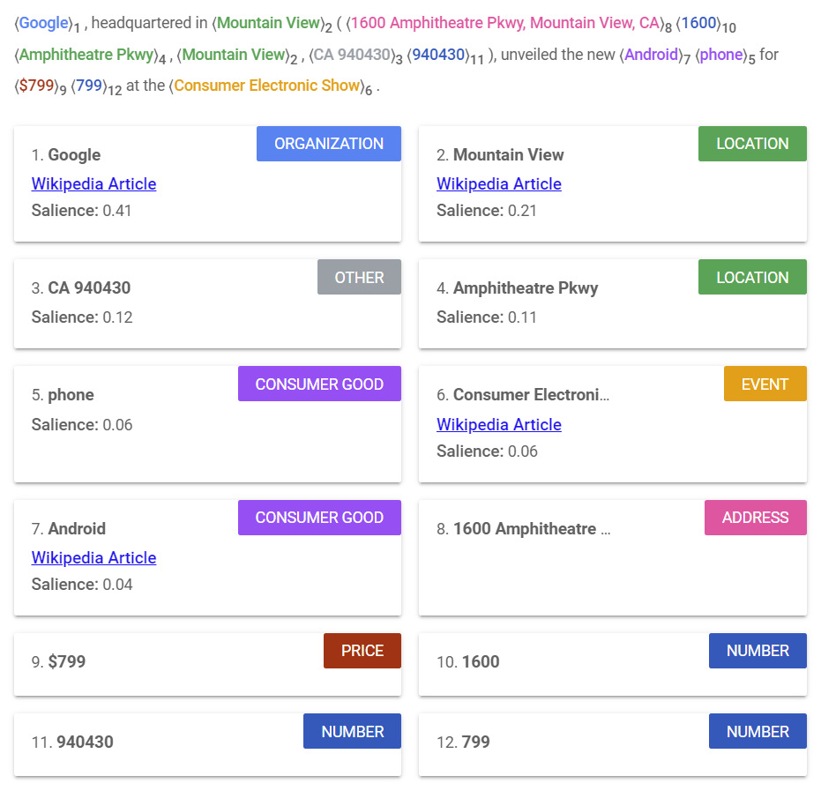
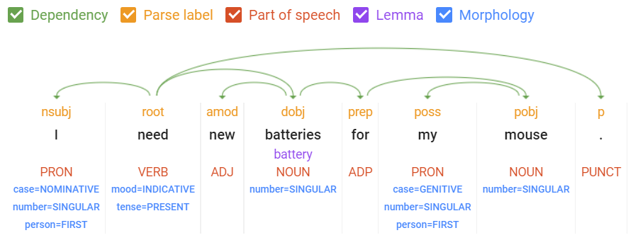
NLP Tasks and Applications
Mostly solved:
Syntax parsing - Part of speech (POS), dependency, etc.
Named Entity Recognition (NER)
https://cloud.google.com/natural-language/

Slide 12
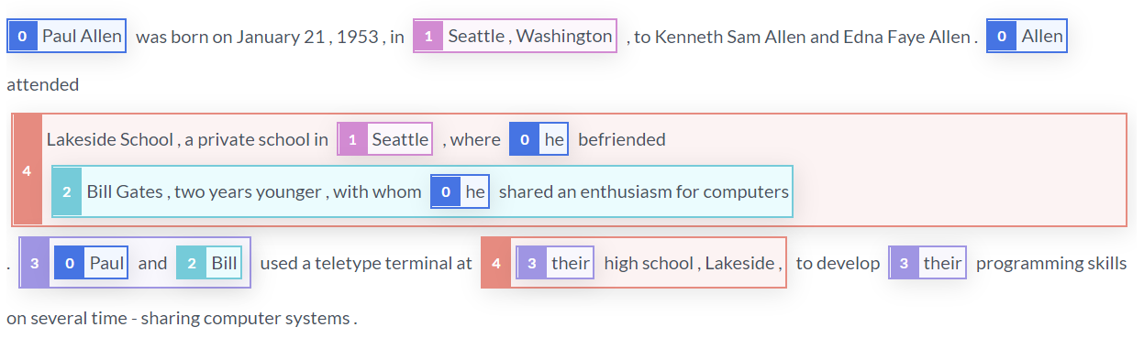
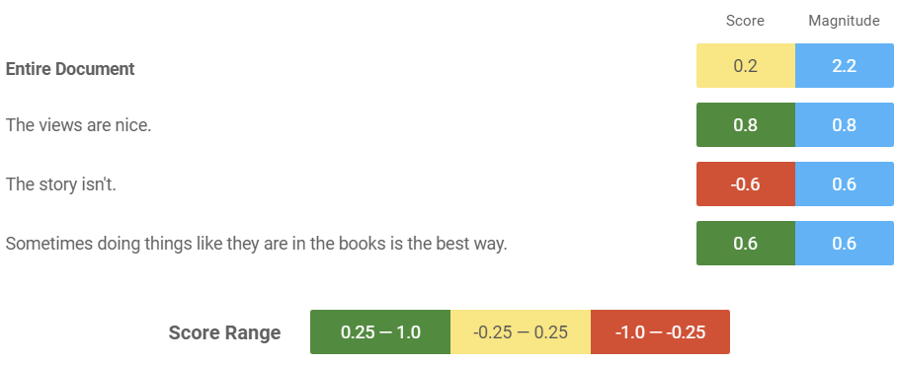
NLP Tasks and Applications
Partially solved:
Coreference resolution
Sentiment analysis
Word Sense disambiguation (WSD) e.g. “I need new batteries for my mouse.”
Machine Translation
https://demo.allennlp.org/

Slide 13
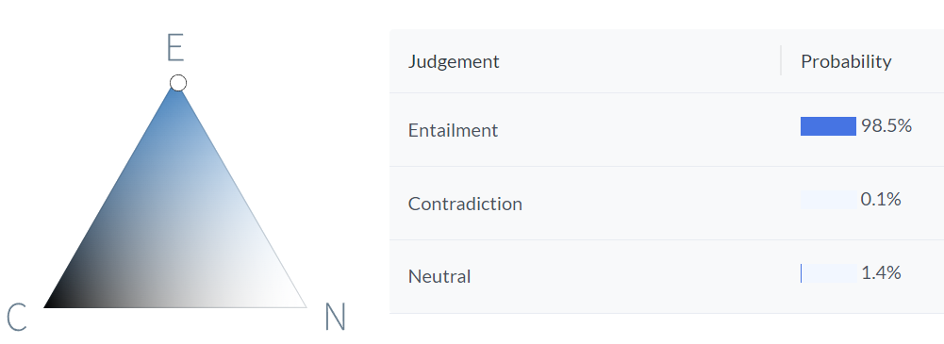
NLP Tasks and Applications
Still hard:
Dialogue understanding and generation
Textual entailment
Reading comprehension
Question answering
Paraphrasing
Summarisation
Premise:
An interplanetary spacecraft is in orbit around a gas giant’s icy moon.
Hypothesis:
The spacecraft has the ability to travel between planets.

Slide 14
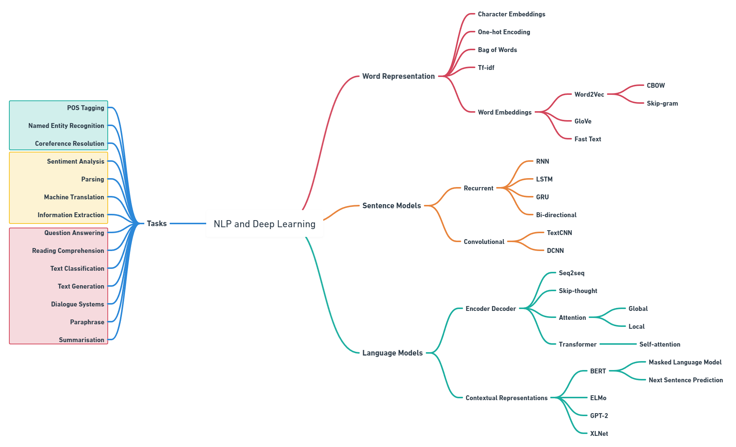

Slide 15

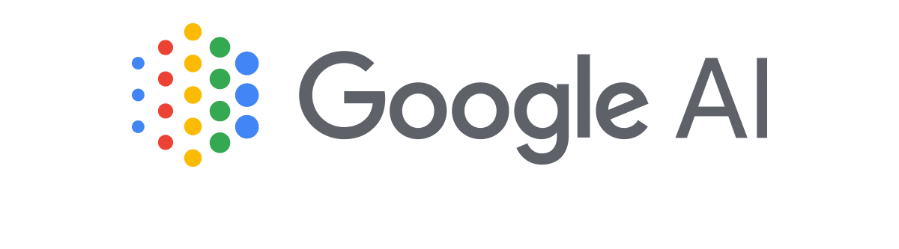


State-of-the-art NLP
For most NLP tasks the SOTA models are based on Transformer architectures and make use of Transfer Learning.
Typically they involve unsupervised training of very large models, with billions of parameters, on huge datasets, with billions of words, e.g. GPT-3 was trained on >500B tokens!
The aim is to create sophisticated generalised models of language which can be fine-tuned for other downstream tasks.

Slide 16
State-of-the-art NLP
SuperGLUE: A Stickier Benchmark for General-Purpose Language Understanding Systems.
Stanford Question Answering Dataset (SQuAD) is a reading comprehension dataset.
Rank | Model | Score
1 | ST-MoE-32B | 91.2
2 | Turing NLR v5 | 90.9
3 | ERNIE 3.0 | 90.6
4 | PaLM 540B | 90.4
5 | T5 + UDG | 90.4
7 | Humans | 89.8
Rank | Model | Score
1 | IE-Net | 93.214
2 | FPNet | 93.183
3 | IE-Net v2 | 93.100
4 | SA-Net Albert | 93.011
5 | SA-Net-V2 | 92.948
- | Humans | 89.452
https://super.gluebenchmark.com/
https://rajpurkar.github.io/SQuAD-explorer/

Slide 17
Some Examples from GLUE
Winograd Reading comprehension:
I tried to keep the dogs out of the kitchen by putting a chair in the middle of the doorway, but it was too [wide/small].
Question: What was too [wide/small]?
Answers: The doorway/the chair.
Stanford Film Sentiment Analysis:
This is a film well worth seeing, talking and singing heads and all. - Positive
In a big corner office in Hell, Satan is throwing up his hands in surrender, is firing his R&D people, and has decided he will just screen The Master of Disguise 24/7. - Negative(?)
https://gluebenchmark.com/

Slide 18
Example from SQuAD
The Normans were the people who in the 10th and 11th centuries gave their name to Normandy, a region in France. They were descended from Norse ("Norman" comes from "Norseman") raiders and pirates from Denmark, Iceland and Norway who, under their leader Rollo, agreed to swear fealty to King Charles III of West Francia… etc…
Q: In what country is Normandy located?
A: France
Q: When were the Normans in Normandy?
A: 10th and 11th centuries.
Q: From which country did the Norse originate?
A: Denmark, Iceland and Norway.
https://rajpurkar.github.io/SQuAD-explorer/

Slide 19
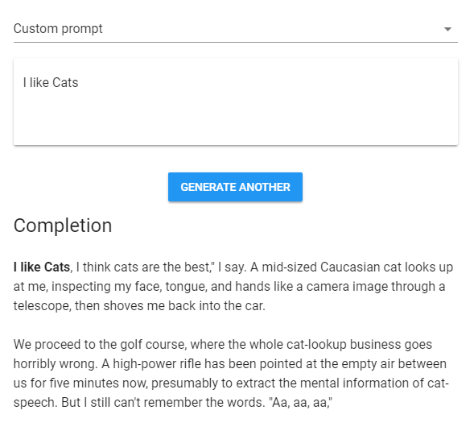
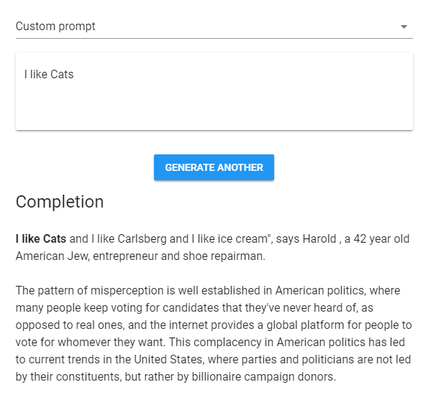
Talking to Transformers…
https://transformer.huggingface.co/
https://app.inferkit.com/demo
Notes:
Write with a Transformer https://transformer.huggingface.co/
Talk to a Transformer https://talktotransformer.com/

Slide 20
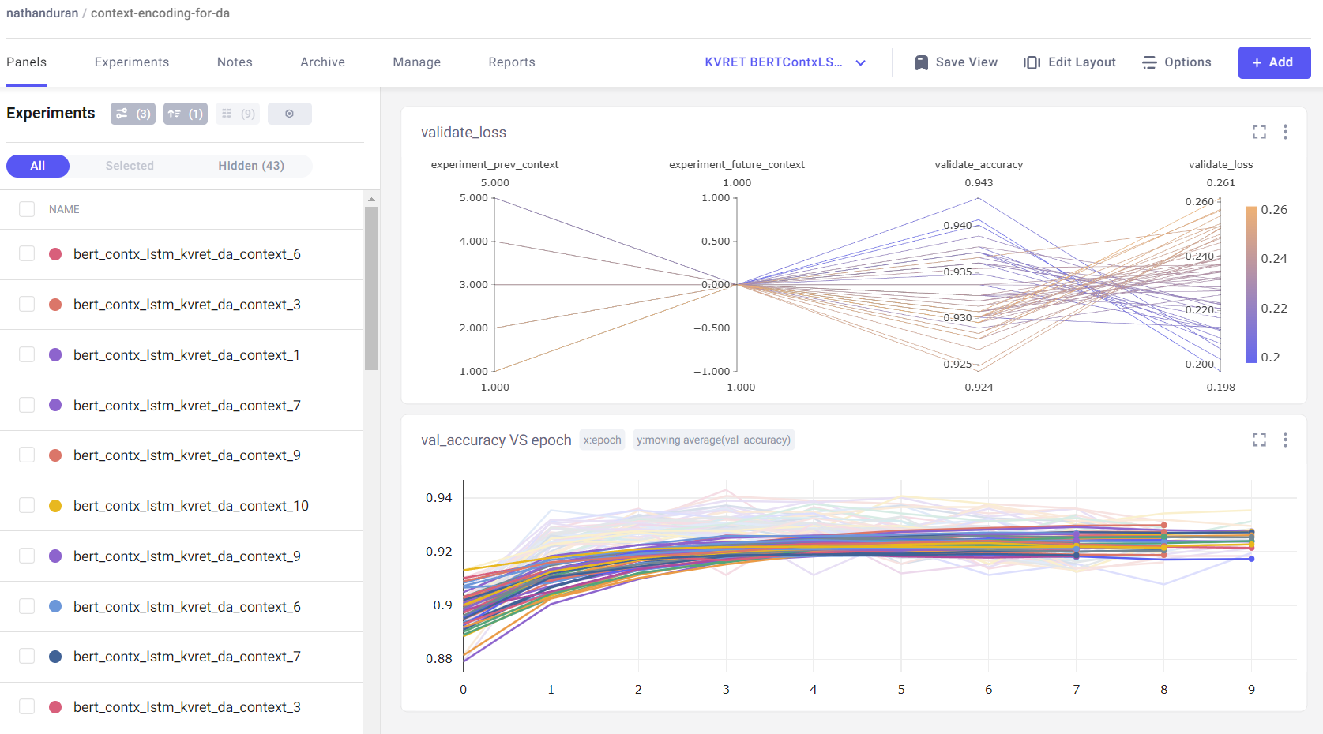



Tools and Libraries
Machine learning platforms:
Integrate within your code to track metrics and tune hyperparameters
Manage and version models/data
Track and compare experiments
Visualise and present results
https://www.comet.com/
https://wandb.ai/site
https://aimstack.io/

Slide 21
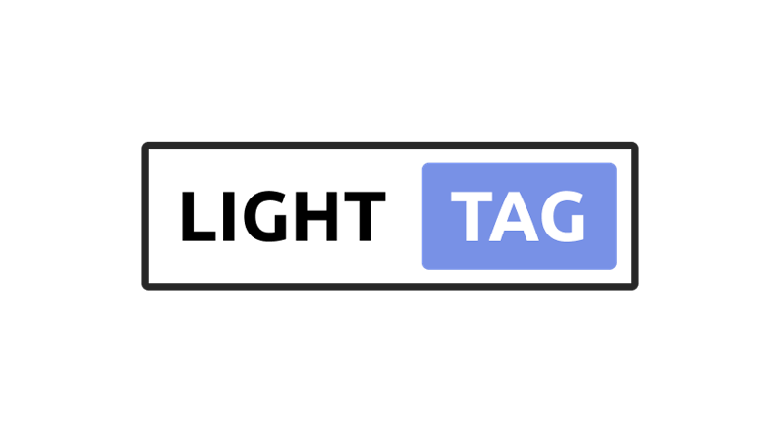

Tools and Libraries
NLP APIs, such as TextRazor and Google Cloud Natural Language AI, provide NLP cloud services:
Typically charge per token/request
Often include common business use-cases - entity recognition, sentiment analysis, translation, parsing, etc.
Data annotation software, such as LightTag and prodigy, provide tools for annotating data:
Unified interface for many typical annotation tasks - entities, sentiment, classes, etc
Some collaboration tools for teams, data verification, metrics, etc.

Slide 22
Text Pre-processing and Representation
Nathan Duran
Notes:
Abstract:
Natural language is highly complex. A word may have different meanings depending on its context and subtle grammatical differences may utterly change the meaning of a sentence. Yet, in computing terms, language representation is often nothing more than a string of characters - a sequence of bytes - which are not able to express the rich and complex syntax and semantics of human languages.
New Natural Language Processing (NLP) and Deep Learning techniques are able to generate representations of words, sentences or documents, which do capture their meaning. Word embedding’s, can model the similarity and relationship between words and sentences, and larger language models, such as BERT, ELMo and GP2, facilitate Natural Language Understanding (NLG) tasks and may even be used to generate text.
We will explore how these techniques and deep learning architectures work and how they have been successfully applied to many classic NLP tasks such as language translation, question answering, text classification and language generation.

Slide 23
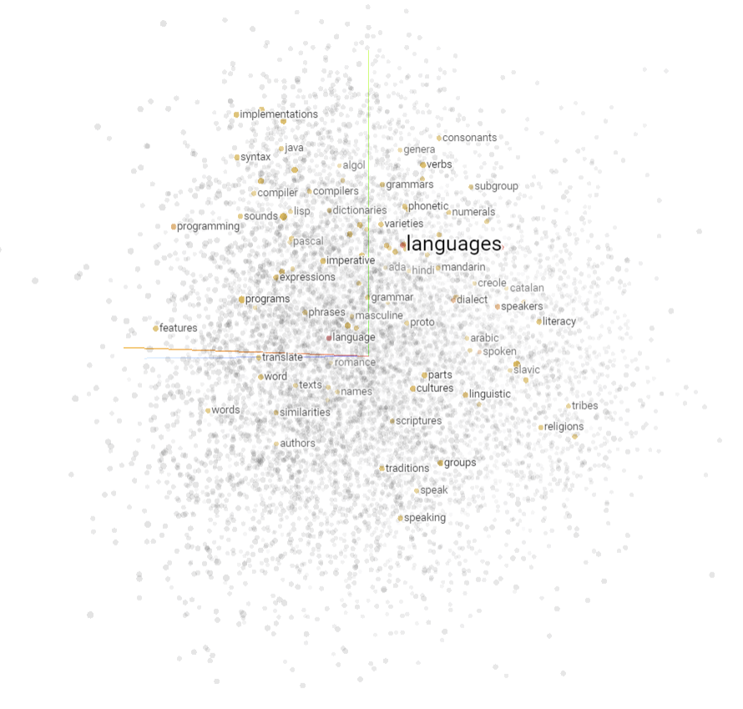
Part 2
Pre-processing and Normalisation
Tokenisation/segmentation
Stemming/lemmatisation
Stop words, case and punctuation
Special chars, HTML, etc
Vocabulary
Representation
Natural language in computable form
Bag-of-words and One-hot
TF-IDF
N-grams
Word vectors

Slide 24
Text Pre-processing and Normalisation
Once we have acquired some data, the first step of any NLP project is pre-processing and normalisation of the text.
The aim is to reduce noise within the data and ensure a consistent set of input features to train the ML model.
Appropriate pre-processing steps are dependent on the source material and goal of the project e.g. if classifying tweets might want to remove @usernames but keep emojis 📌😎. What about #hashtags??

Slide 25
Tokenisation and Segmentation
Tokenisation involves splitting text into discrete tokens e.g. words, punctuation and other symbols.
More complex than simply splitting on spaces. Consider hyphenated words, quotations and contractions.
Segmentation typically refers to splitting larger texts into coherent segments, such as sentences or topics.
Let's visit my father-in-law in St. Louis next year. He said “it would be fun!”
[Let, 's, visit, my, father, -, in, -, law, in, St., Louis, next, year, .]
[He, said, “, it, would, be, fun, !, ”]

Slide 26
Stemming and Lemmatisation
It can be useful to normalise word forms to create a uniform representation of similar word types. This helps reduce the number of word variants, e.g. for search queries.
Not necessarily useful for some tasks as we may want to retain the distinct words.
Stemming removes the prefix (beginning) or suffix (end) of a word. Crude, and doesn’t always result in a real word.
Lemmatisation reduces words to their base form e.g. removing tense or pluralisation. Need to find the correct dictionary word.
Form | Suffix | Stem
studies | es | studi
studying | ing | study
automatic | ic | automat
automation | ation | autom
studies, studying → study
are, is → be
car, cars → car

Slide 27
Stop words, Case-folding and Punctuation
Stop words are words considered insignificant or unhelpful, usually because they are very common (the, a, and, is, etc). A stop list is a set of words that are removed during pre-processing.
Case-folding simply changes all letters to lower case. Prevents repeating words due to capitalisation e.g. at the beginning of sentences. Be careful of e.g. US versus us.
Punctuation can be removed or kept which is dependant on the task e.g. Dialogue Act classification.
[Let, visit, father, -, -, law, St., Louis, year, .]
[said, “, fun, !, ”]
[let, 's, visit, my, father, -, in, -, law, in, st., louis, next, year, .]
[he, said, ', it, would, be, fun, !, ‘]
[Let, 's, visit, my, father, in, law, in, St., Louis, next, year]
[He, said, it, would, be, fun]
Duran, N., Battle, S. and Smith, J. (2021) Sentence encoding for Dialogue Act classification. Natural Language Engineering

Slide 28
Whitespace, Special Chars and Contractions
Whitespace characters, such as \n and \t. In some cases there may be extra whitespace that needs to be trimmed.
Special characters, such as brackets, #, @, *, characters with accents, etc.
Contractions, such as I’ve and that’s to I have and that is.
There are helpful libraries available for these: TextaCy, contractions, unicode and num2word.
Let's visit my fáther-in-law in @St. Louis next year. He said “it would be #fun!”
[Let, us, visit, my, father, in, law, in, St., Louis, next, year, .]
[He, said, “, it, would, be, fun, !, ”]
https://textacy.readthedocs.io/en/latest/index.html

Slide 29
HTML, Emoji and Numbers
HTML tags, email addresses, URL’s etc.
Emojis could replace with special token to represent sentiment, or just remove.
Numbers to words and vice-versa e.g. 100 to one hundred.
There are helpful libraries available for these: TextaCy, contractions, unicode and num2word.
<a href=‘site.com' class=‘link'> Let's visit my \t #father-in-law @ St. Louis next year.\n <b>He said 'it would be fun!’ 😂 </b></a><br>
[Let, 's, visit, my, father, -, in, -, law, in, St., Louis, next, year, .]
[He, said, “, it, would, be, fun, !, ”]
https://textacy.readthedocs.io/en/latest/index.html

Slide 30
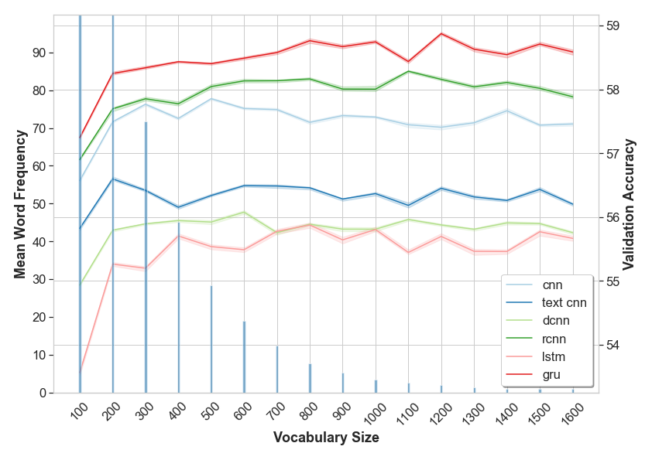
Vocabulary
It is often useful to create a vocabulary once text has been processed.
Can determine how many words/tokens to keep within the data (the vocab_size) and discarding those that are less frequently occurring.
Used to map tokens to indices (numbers) for input into ML models i.e. vectorise (everything must be a number!).
Allows us to add special tokens, like <unk> to replace unknown/out-of-vocabulary (OOV) words, and <pad> to pad inputs to a given length.
It isn’t always useful to include the entire vocabulary. Beyond a certain point words (features) appear so infrequently they may have little impact on the model.
Duran, N., Battle, S. and Smith, J. (2021) Sentence encoding for Dialogue Act classification. Natural Language Engineering

Slide 31
Language Representation
Once the text has been pre-processed, cleaned and normalised it is still not in the right format for ML.
Of course you cannot simply input word(s) to an ML model, everything must be represented as numbers.
Even better, how do you represent the meaning of a word as a number?
How do you represent the relationship between words as numbers?

Slide 32
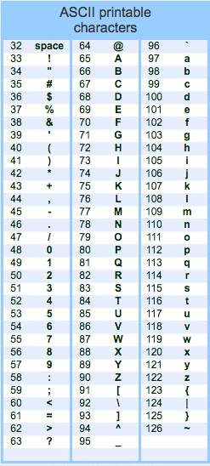
Language Representation
For most purposes text is just a sequence of characters encoded as a number (a Byte) using, for example, ASCII (American Standard Code for Information Interchange) or some other encoding (e.g. UTF-8).
These numbers/encodings have no relationship with the characters they represent.
Also, we need inputs of the same size, so cant just concatenate letters.
Can vectorise the words by simply replacing each one with a number – its index in the vocabulary. Or build a character model…

Slide 33
One-hot Encodings
Represent words as an array with length = vocab_size.
A 1 at the position/index of the word in the vocabulary and the rest are 0’s.
Sentences are then 2D arrays of n_words x vocab_size.
A large vocabulary creates very large sentence matrices but size for each word is uniform.
Difficult to represent paragraphs/larger texts, no grammar and no meaning of a word or relationship to others…
 | Sentence
Vocabulary | I | like | cats.
Aardvark | 0 | 0 | 0
Cats | 0 | 0 | 1
I | 1 | 0 | 0
Like | 0 | 1 | 0
Lion | 0 | 0 | 0
… | … | … | …
Zebra | 0 | 0 | 0

Slide 34
Bag-of-words
A BOW represent sentences as an array with length = vocab_size.
Simply count the number of times a word appears in the sequence and store count according to the word’s index within the vocabulary.
More efficient than one-hot for sentence representation, but word order is lost.
Difficult to represent paragraphs/larger texts, no grammar and still no meaning of a word or relationship to others…
This is a test sentence which is a very long test sentence.
Vocab: ['test', '.', 'a', 'long', 'is', 'which', 'This', 'very', 'sentence’, ‘cat’, ‘dog’]
BOW: [2 1 2 1 2 1 1 1 2 0 0]

Slide 35
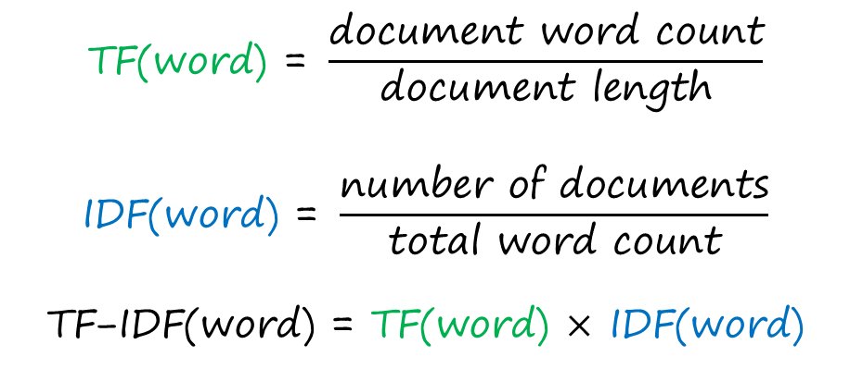
TF-IDF
Term Frequency - Inverse Document Frequency quantifies the relative importance of words within a set of documents (a corpus).
TF is the frequency of a word within a document. Affected by the length of the document and frequency of the word i.e. a common word will appear more often in a document with 100 words than one with 10.
IDF is the frequency of a word within the corpus. Taking the inverse ensures common words receive lower weights.
$$\text{TF}\text{(}\text{word}\text{) = }\frac{\text{document} \text{word} \text{count}}{\text{document} \text{length}}$$
$$\text{IDF}\text{(}\text{word}\text{) = }\frac{\text{number} \text{of} \text{documents}}{\text{total} \text{word} \text{count}}$$
$$\text{TF}\text{−}\text{IDF}\text{(}\text{word}\text{) = }\text{TF}\text{(}\text{word}\text{) }\text{×} \text{IDF}\text{(}\text{word}\text{)}$$

Slide 36
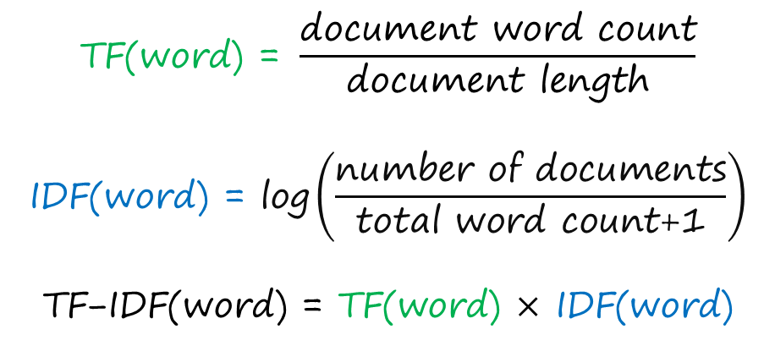
TF-IDF
With a large corpus, words that occur infrequently will have a high IDF score. So take the log of IDF.
There may also be words within our vocabulary that do not appear in the corpus so apply smoothing - add 1 to words document frequency and avoid zero division error.
Some implementations also apply normalisation (l1 or l2) to the word scores.
$$\text{TF}\text{(}\text{word}\text{) = }\frac{\text{document} \text{word} \text{count}}{\text{document} \text{length}}$$
$$\text{IDF}\text{(}\text{word}\text{) = }\text{log}\left(\frac{\text{number} \text{of} \text{documents}}{\text{total} \text{word} \text{count}\text{+1}}\right)$$
$$\text{TF}\text{−}\text{IDF}\text{(}\text{word}\text{) = }\text{TF}\text{(}\text{word}\text{) }\text{×} \text{IDF}\text{(}\text{word}\text{)}$$

Slide 37
N-grams
N-grams are sequences of N words. Typically uni-grams (1), bi-grams (2), tri-grams (3), etc.
Unlike previous examples, bi-grams (or larger) start to provide some context to words.
Context is important for representing meaning e.g. homonyms - words that are spelled and sound the same but have multiple meanings.
Bi-grams (or larger) can be used in BOW and TF-IDF representations in place of uni-grams. We can also build simple n-gram language models (more on this in next week).
I sat by the river bank
Bi-grams: (I, sat), (sat, by), (by, the), (the, river), (river, bank)
Tri-grams: (I, sat, by), (sat, by, the), (by, the, river), (the, river, bank)

Slide 38
Word Vectors
CBOW
Sliding window
Representing words as a vector (list) of real numbers that capture some of their meaning and relationship with other words.
Word2vec^{(1, 2)} and GloVe⁽³⁾ are the most common and typically require large amounts of data, some 100’s of millions words.
Continuous Bag-of-words (CBOW): predict target word given context words.
Skip-gram: given context word predict surrounding target words.
efficient method of learning vector representation
Context words
Context words
Target word
Skip-gram
efficient method of learning vector representation
Target words
Target words
Context word
Mikolov, T., et al. (2013). Efficient Estimation of Word Representations in Vector Space
Mikolov, T., et al. (2013) Distributed Representations of Words and Phrases and Their Compositionality.
Pennington, J., Socher, R., & Manning, C. D. (2014). GloVe: Global Vectors for Word Representation.

Slide 39
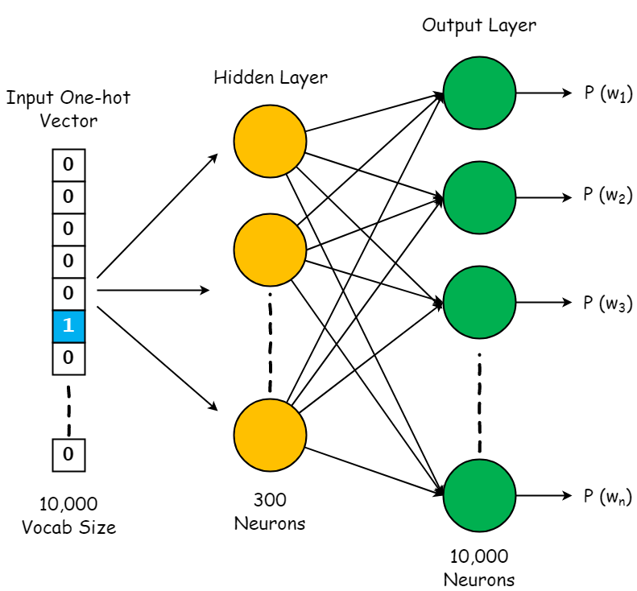
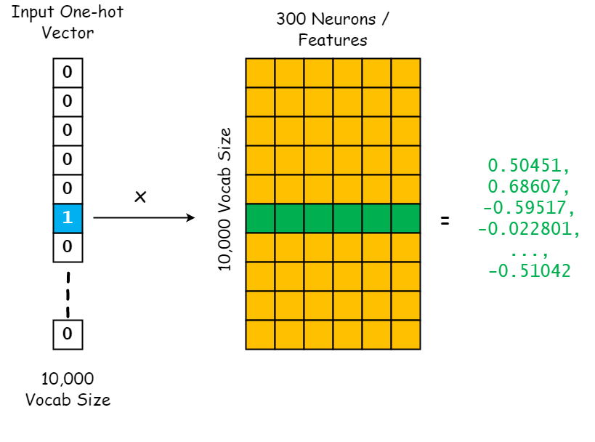
Word Vectors
CBOW Model
Word Vector Lookup Table

Slide 40
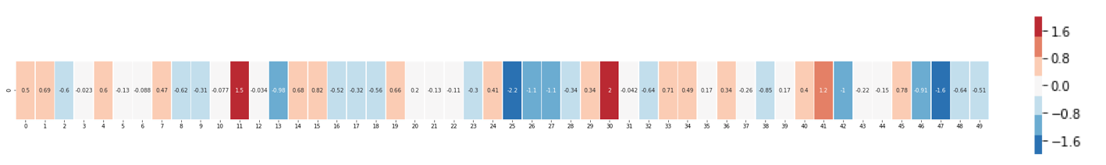
Word Vectors
What we end up with for “king” (GloVe trained on Wikipedia):
[ 0.50451 , 0.68607 , -0.59517 , -0.022801, 0.60046 , -0.13498 , -0.08813 , 0.47377 , -0.61798 , -0.31012 , -0.076666, 1.493 , -0.034189, -0.98173 , 0.68229 , 0.81722 , -0.51874 , -0.31503 , -0.55809 , 0.66421 , 0.1961 , -0.13495 , -0.11476 , -0.30344 , 0.41177 , -2.223 , -1.0756 , -1.0783 , -0.34354 , 0.33505 , 1.9927 , -0.04234 , -0.64319 , 0.71125 , 0.49159 , 0.16754 , 0.34344 , -0.25663 , -0.8523 , 0.1661 , 0.40102 , 1.1685 , -1.0137 , -0.21585 , -0.15155 , 0.78321 , -0.91241 , -1.6106 , -0.64426 , -0.51042 ]
Colour coded for visualisation:
https://jalammar.github.io/illustrated-word2vec/

Slide 41
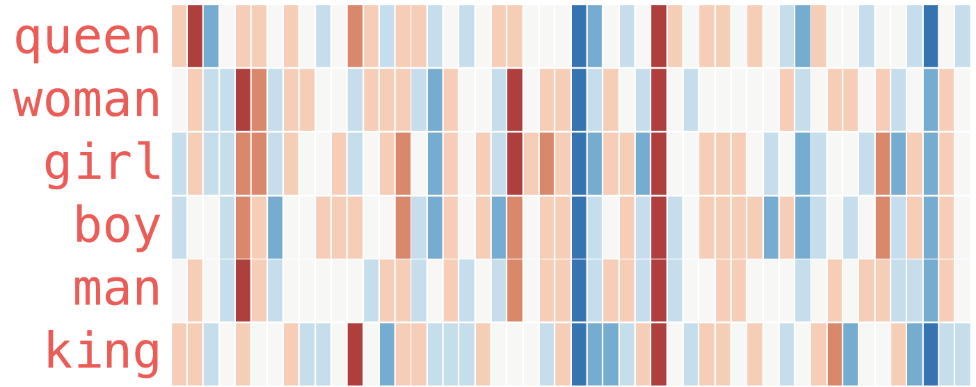
https://jalammar.github.io/illustrated-word2vec/

Slide 42
https://jalammar.github.io/illustrated-word2vec/

Slide 43
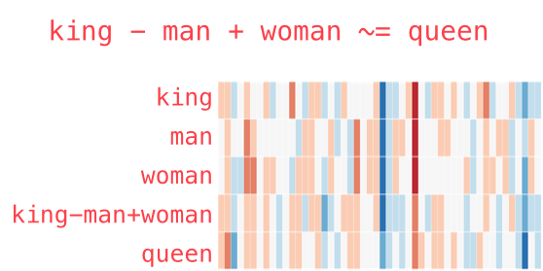
Now we can do some maths (analogies) with the vectors!
http://projector.tensorflow.org/
https://research.google.com/semantris/

Slide 44
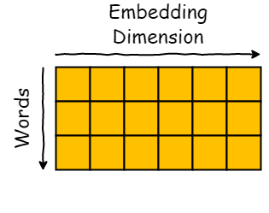
Word Vectors
I | like | cats
0 | 0 | 1
1 | 0 | 0
0 | 1 | 0
We have moved from a ‘sparse’ word representations (one-hot/BOW).
To ‘dense’ real-valued vectors.
Vectors have some relatedness and word meaning embedded within them.
Word embeddings (vectors) can now be used as input for all kinds of NLP tasks.
Sentence similarity, sentiment, classification, etc.
Transfer Learning!
I [0.47682 , 0.68607 , -0.59517 , …]
like [0.34567 , -0.48976 , 1.49375 , …]
Cats [0.78321 , -0.91241 , -1.6106 , …]

Slide 45
Text Classification
Nathan Duran
Notes:
Abstract:
Natural language is highly complex. A word may have different meanings depending on its context and subtle grammatical differences may utterly change the meaning of a sentence. Yet, in computing terms, language representation is often nothing more than a string of characters - a sequence of bytes - which are not able to express the rich and complex syntax and semantics of human languages.
New Natural Language Processing (NLP) and Deep Learning techniques are able to generate representations of words, sentences or documents, which do capture their meaning. Word embedding’s, can model the similarity and relationship between words and sentences, and larger language models, such as BERT, ELMo and GP2, facilitate Natural Language Understanding (NLG) tasks and may even be used to generate text.
We will explore how these techniques and deep learning architectures work and how they have been successfully applied to many classic NLP tasks such as language translation, question answering, text classification and language generation.

Slide 46
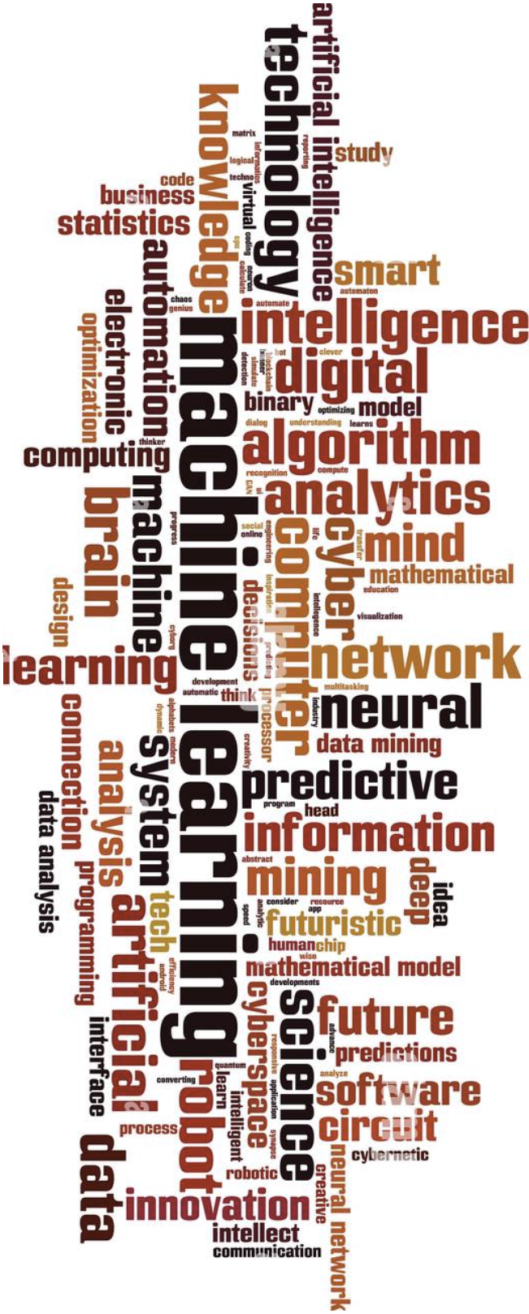
Part 3
NLP Classification
Generative vs Discriminative
Supervised
Naïve Bayes
ANN for NLP
Recurrent and Convolutional
Unsupervised
K-means
Semantic Similarity

Slide 47
NLP Classification
Many NLP tasks can be formulated as a classification problem:
Spam detection, sentiment analysis, topic identification, intent/dialogue act recognition.
In fact, even more complex tasks, such as language modelling (next week ), can be viewed as classification with many (vocab_size) classes.
Process is similar to more ‘traditional’/numerical data:
gather/process data → build model → evaluate
Considerations – NLP/Task specific:
Pre-processing: What to keep/remove from source text?
Representation: Which numerical representation method? What is an input example composed of – a single sentence, a sequences of sentences, a paragraph?
Model selection: Does task/representation inform model? Do entity relations or distribution matter?

Slide 48
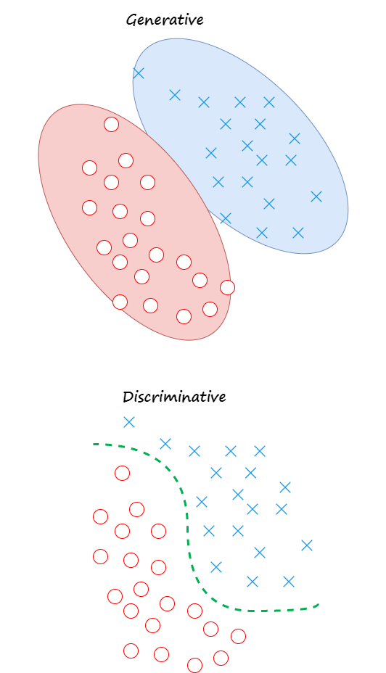
Generative vs Discriminative
Generative models use the distribution of the data to determine where input features map to the expected output.
Estimate joint probabilities P(x, y) e.g. using Bayes theorem
Sensitive to outliers
Naïve Bayes, HMM, etc
Discriminative models learn a decision boundary to separate the classes and select appropriate labels based on the input features.
Estimate conditional probability P(y | x)
ANN, SVM, Regression, Decision Trees, etc.

Slide 49
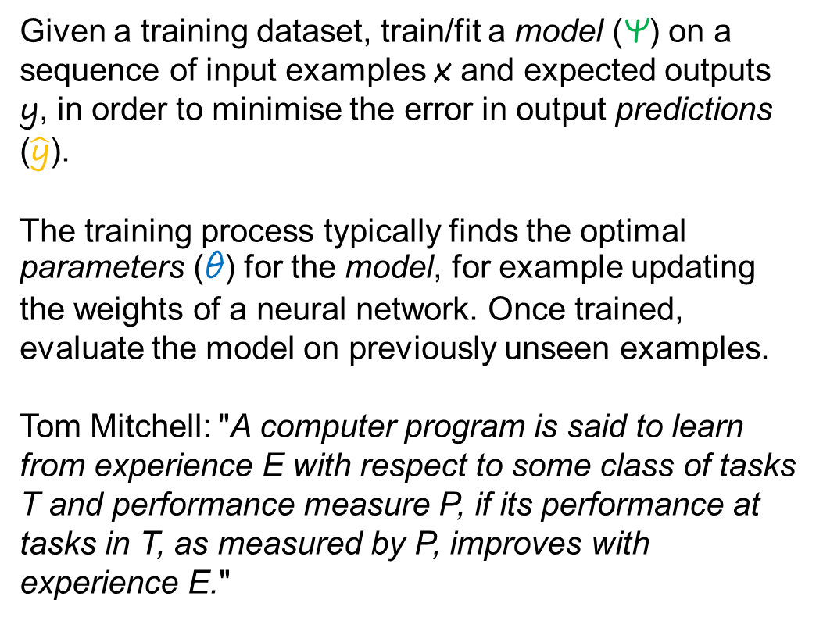
Supervised Learning
Given a training dataset, train/fit a model (Ψ) on a sequence of input examples x and expected outputs y, in order to minimise the error in output predictions ($\hat{\text{y}}$).
The training process typically finds the optimal parameters (θ) for the model, for example updating the weights of a neural network. Once trained, evaluate the model on previously unseen examples.
Tom Mitchell: "A computer program is said to learn from experience E with respect to some class of tasks T and performance measure P, if its performance at tasks in T, as measured by P, improves with experience E."

Slide 50
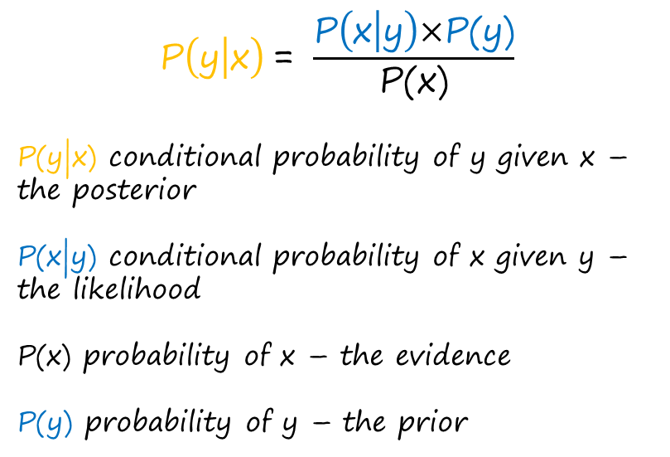
Naïve Bayes
Naïve Bayes is a generative classification algorithm which finds the probability of an event based on prior knowledge/examples of similar events.
The key idea: the probability of an example belonging to a given class is conditional on how often the example (its features) are present among other examples from that class.
It is naïve, because it assumes that each feature is independent (do not effect each other) so we can calculate probabilities independently.
$$\text{P}\left(\text{y} | \text{x}\right) \text{= }\frac{\text{P}\left(\text{x} | \text{y}\right)\text{×}\text{P}\text{(}\text{y}\text{)}}{\text{P}\text{(}\text{x}\text{)}}$$
P(y|x) conditional probability of y given x – the posterior
P(x|y) conditional probability of x given y – the likelihood
P(x) probability of x – the evidence
P(y) probability of y – the prior

Slide 51
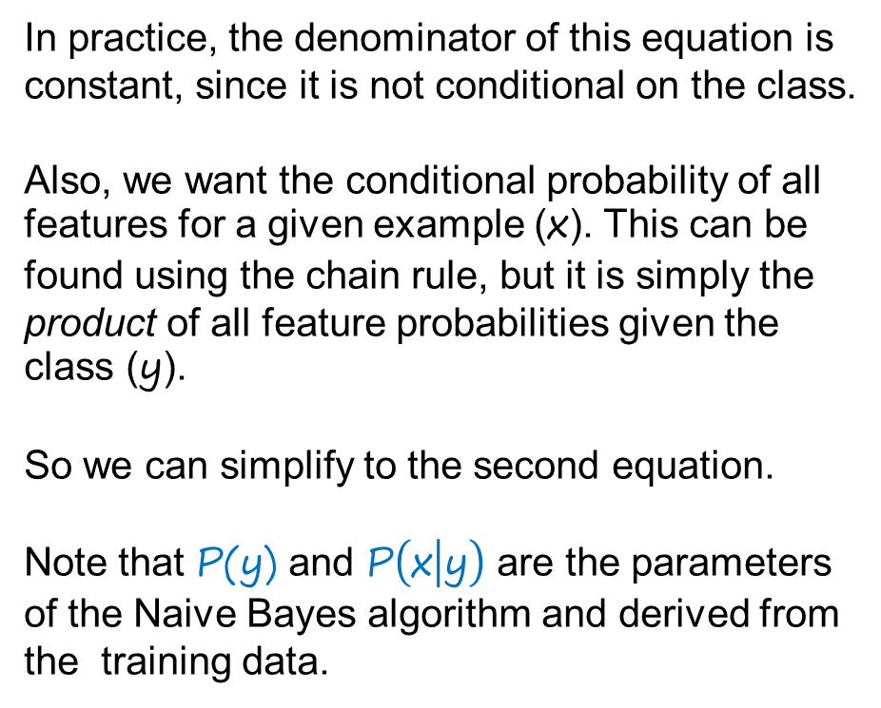
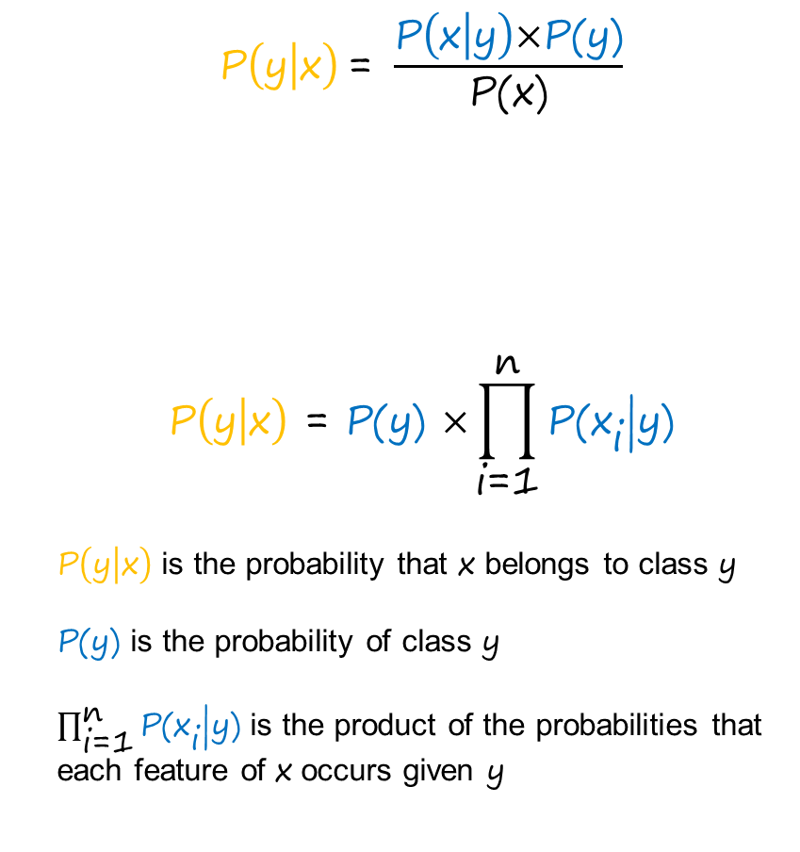
Naïve Bayes
$$\text{P}\left(\text{y} | \text{x}\right) \text{= }\frac{\text{P}\left(\text{x} | \text{y}\right)\text{×}\text{P}\text{(}\text{y}\text{)}}{\text{P}\text{(}\text{x}\text{)}}$$
$$\text{P}\left(\text{y} | \text{x}\right)\text{ = }\text{P}\text{(}\text{y}\text{) }\text{×}\prod_{\text{i}\text{=1}}^{\text{n}}{\text{P}\text{(}{\text{x}}_{\text{i}}\text{|}\text{y}\text{)}}$$
$\text{P}\left(\text{y} | \text{x}\right)$ is the probability that x belongs to class y
$\text{P}\text{(}\text{y}\text{)}$ is the probability of class y
$\prod_{\text{i}\text{=1}}^{\text{n}}{\text{P}\text{(}{\text{x}}_{\text{i}}\text{|}\text{y}\text{)}}$ is the product of the probabilities that each feature of x occurs given y
In practice, the denominator of this equation is constant, since it is not conditional on the class.
Also, we want the conditional probability of all features for a given example (x). This can be found using the chain rule, but it is simply the product of all feature probabilities given the class (y).
So we can simplify to the second equation.
Note that $\text{P}\text{(}\text{y}\text{)}$ and $\text{P}\left(\text{x} | \text{y}\right)$ are the parameters of the Naive Bayes algorithm and derived from the training data.

Slide 52
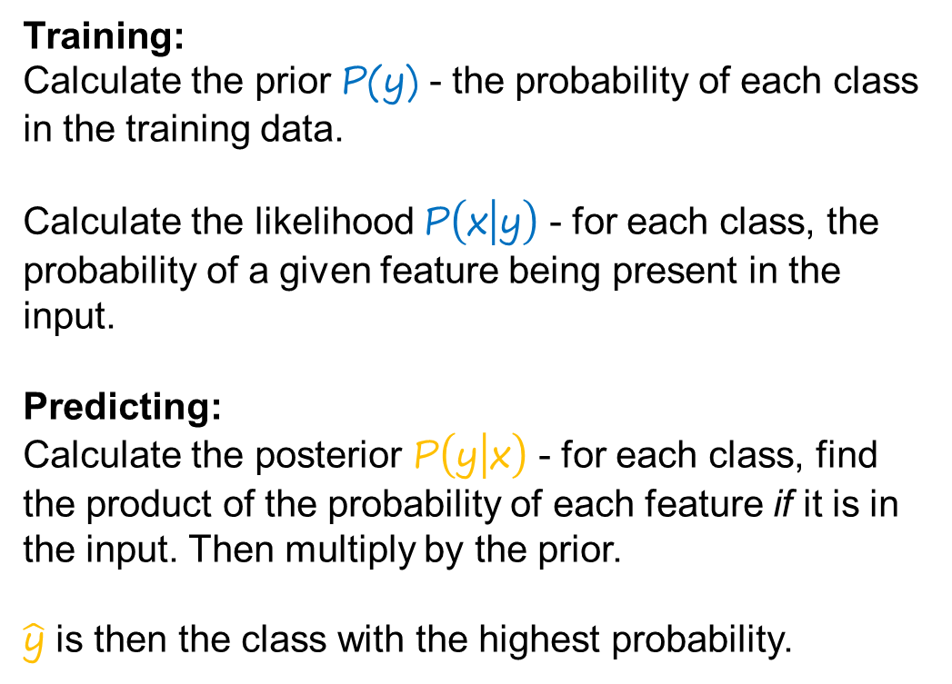
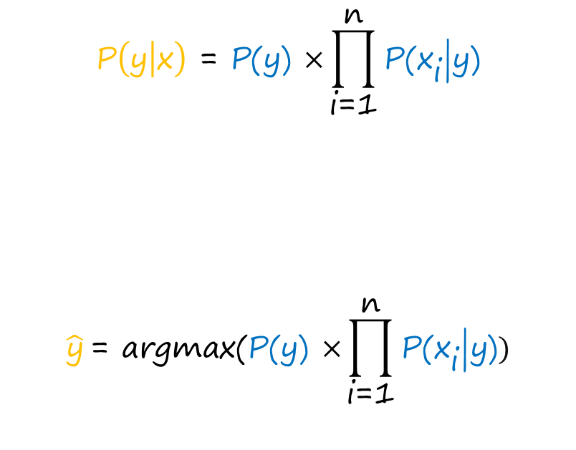
Naïve Bayes
Training:
Calculate the prior $\text{P}\text{(}\text{y}\text{)}$ - the probability of each class in the training data.
Calculate the likelihood $\text{P}\left(\text{x} | \text{y}\right)$ - for each class, the probability of a given feature being present in the input.
Predicting:
Calculate the posterior $\text{P}\left(\text{y} | \text{x}\right)$ - for each class, find the product of the probability of each feature if it is in the input. Then multiply by the prior.
$\hat{\text{y}}$ is then the class with the highest probability.
$$\text{P}\left(\text{y} | \text{x}\right)\text{ = }\text{P}\text{(}\text{y}\text{) }\text{×}\prod_{\text{i}\text{=1}}^{\text{n}}{\text{P}\text{(}{\text{x}}_{\text{i}}\text{|}\text{y}\text{)}}$$
$$\hat{\text{y}} \text{= }\text{argmax}\text{(}\text{P}\text{(}\text{y}\text{) }\text{×}\prod_{\text{i}\text{=1}}^{\text{n}}{\text{P}\text{(}{\text{x}}_{\text{i}}\text{|}\text{y}\text{)}})$$

Slide 53
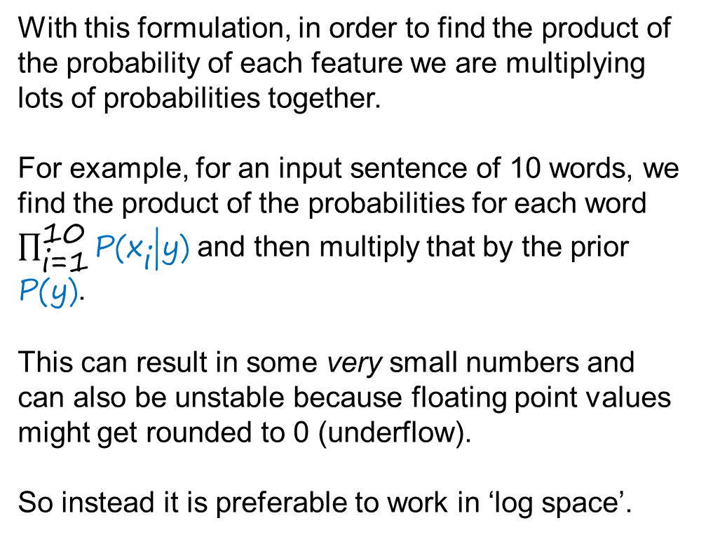
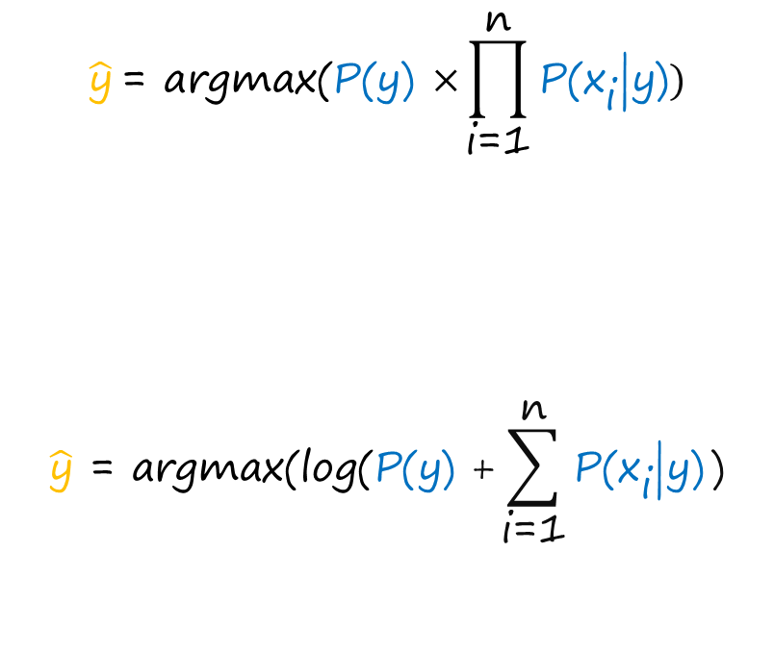
Naïve Bayes
With this formulation, in order to find the product of the probability of each feature we are multiplying lots of probabilities together.
For example, for an input sentence of 10 words, we find the product of the probabilities for each word $\prod_{\text{i}\text{=1}}^{\text{10}}{\text{P}\text{(}{\text{x}}_{\text{i}}\text{|}\text{y}\text{)}}$ and then multiply that by the prior $\text{P}\text{(}\text{y}\text{)}$.
This can result in some very small numbers and can also be unstable because floating point values might get rounded to 0 (underflow).
So instead it is preferable to work in ‘log space’.
$$\hat{\text{y}} \text{= }\text{argmax}\text{(}\text{P}\text{(}\text{y}\text{) }\text{×}\prod_{\text{i}\text{=1}}^{\text{n}}{\text{P}\text{(}{\text{x}}_{\text{i}}\text{|}\text{y}\text{)}})$$
$$\hat{\text{y}} \text{= }\text{argmax}\text{(}\text{log}\text{(}\text{P}\text{(}\text{y}\text{) +}\sum_{\text{i}\text{=1}}^{\text{n}}{\text{P}\text{(}{\text{x}}_{\text{i}}\text{|}\text{y}\text{)}}\text{)}$$

Slide 54
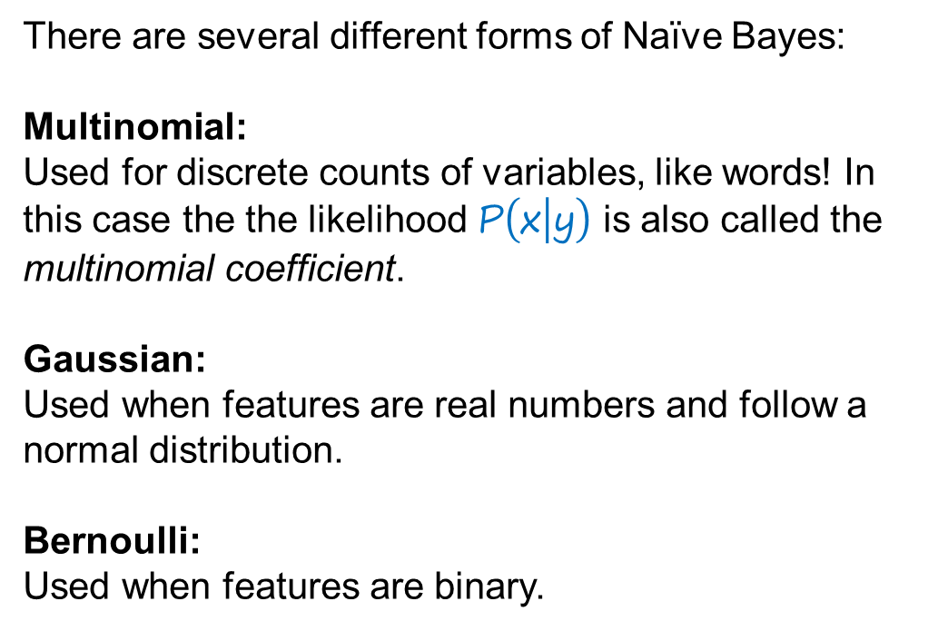
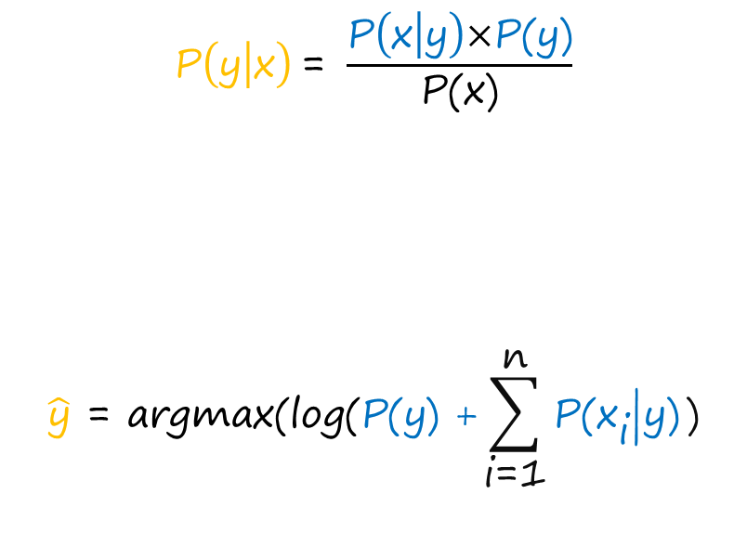
Naïve Bayes
There are several different forms of Naïve Bayes:
Multinomial:
Used for discrete counts of variables, like words! In this case the the likelihood $\text{P}\left(\text{x} | \text{y}\right)$ is also called the multinomial coefficient.
Gaussian:
Used when features are real numbers and follow a normal distribution.
Bernoulli:
Used when features are binary.
$$\text{P}\left(\text{y} | \text{x}\right) \text{= }\frac{\text{P}\left(\text{x} | \text{y}\right)\text{×}\text{P}\text{(}\text{y}\text{)}}{\text{P}\text{(}\text{x}\text{)}}$$
$$\hat{\text{y}}\text{ = }\text{argmax}\text{(}\text{log}\text{(}\text{P}\text{(}\text{y}\text{) +}\sum_{\text{i}\text{=1}}^{\text{n}}{\text{P}\text{(}{\text{x}}_{\text{i}}\text{|}\text{y}\text{)}}\text{)}$$

Slide 55
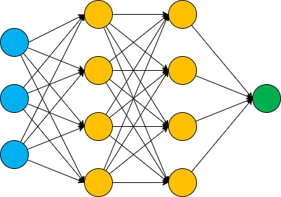
ANN for NLP
In principal we can apply ANNs to NLP tasks in the same manner as any other. Yet, there are some important differences when it comes to NLP.
Each node in the input layer corresponds to a feature of the input examples. For NLP this will typically be words or characters, but what constitutes a feature changes depending on the chosen input representations.
BOW/TF-IDF - have vocab_size number of features, regardless of input length.
Word embeddings - have max_sequence_length x embedding_dimension features!

Slide 56
ANN for NLP
Recall that embeddings map each word to a vector of real numbers, the embedding_dimension or number of features.
So, an input sequence becomes a matrix (2D array/Tensor) of size max_sequence_length x embedding_dimension.
This shape is not easily compatible with a ‘traditional’ feed forward ANN. Instead we need different architecture - Convolutional or Recurrent ANN.
These representations can also get very large, so memory is a consideration!
I [0.47682 , 0.68607 , -0.59517 , …]
like [0.34567 , -0.48976 , 1.49375 , …]
Cats [0.78321 , -0.91241 , -1.6106 , …]

Slide 57
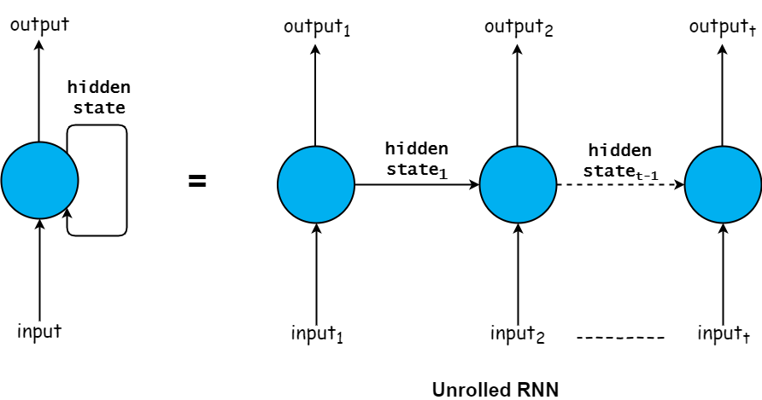
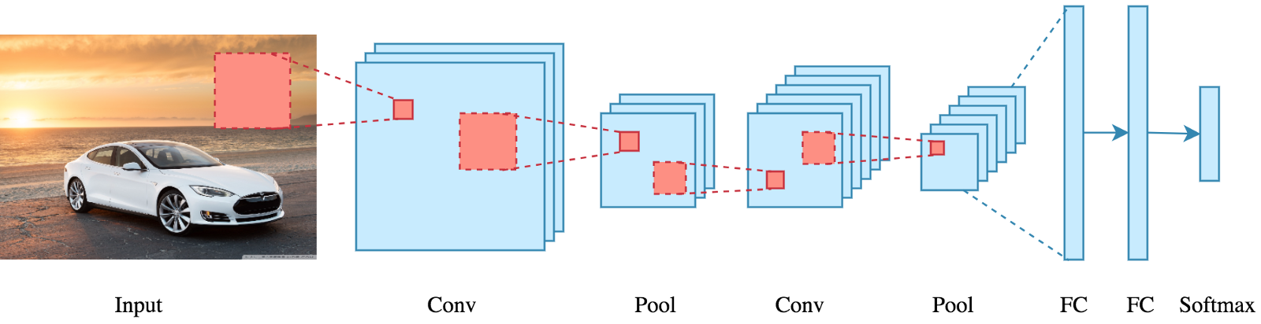
Reminder: Recurrent and Convolutional Networks
Recurrent NN:
Process sequential data with a temporal relationship e.g. time series, or text!
Have a kind of ‘memory’ in the form of hidden state.
Convolutional NN:
Primarily intended for image data, which can be 2 or more dimensions.
CNN pass a moving ‘window’ over the image to find important features.

Slide 58
A More Complex Example (from Nathan’s PhD.)
A contextual Dialogue Act classifier: Uses a pre-trained language model based on the Transformer architecture (week 6) to processes each utterance in a segment of dialogue.
Also encodes and joins the speaker and previous utterance labels into a dialogue segment encoding.
Example of the composition informs the input representations - sequence of utterances.
In addition, the relations between other problem features (speakers), informs the model architecture.

Slide 59
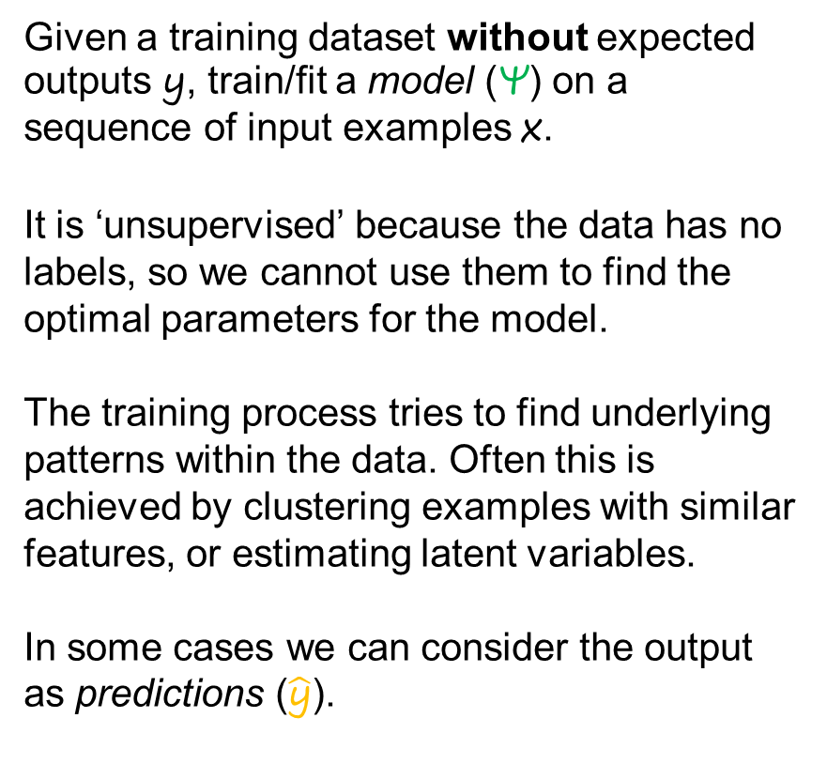
Unsupervised Learning
Given a training dataset without expected outputs y, train/fit a model (Ψ) on a sequence of input examples x.
It is ‘unsupervised’ because the data has no labels, so we cannot use them to find the optimal parameters for the model.
The training process tries to find underlying patterns within the data. Often this is achieved by clustering examples with similar features, or estimating latent variables.
In some cases we can consider the output as predictions ($\hat{\text{y}}$).

Slide 60
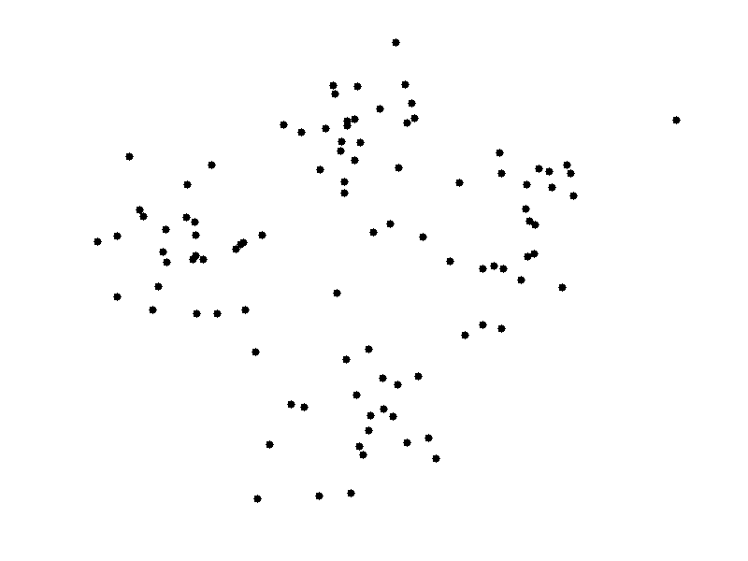
K-means
K-means is a clustering algorithm which defines a set of centroids (mid-points) for each cluster.
Examples are assigned to the closest cluster/centroid. Centroids are repeatedly moved to a new mid-point of all examples in the cluster, until no further changes are made.
For NLP need to consider input representations:
Calculating the distance/similarity between examples, lots of common but uninformative words will tend to make examples appear closer/more similar.
Zero values will also have no impact on distance metric.

Slide 61
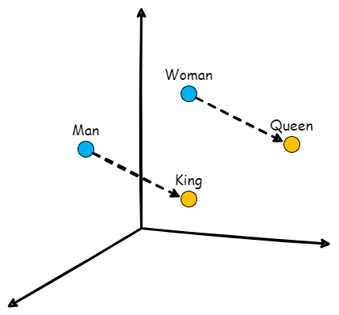
Semantic Similarity
Word embeddings capture a representation of the words meaning and related words appear close to each other in vector space.
So, we can use embeddings to find semantically similar words, or even analogies.
King - man + woman ~= Queen
To find semantically similar words we just need to calculate the distance between a target word and all other word vectors.

Slide 62
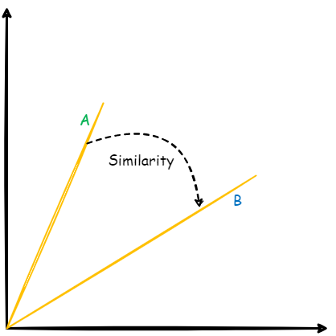
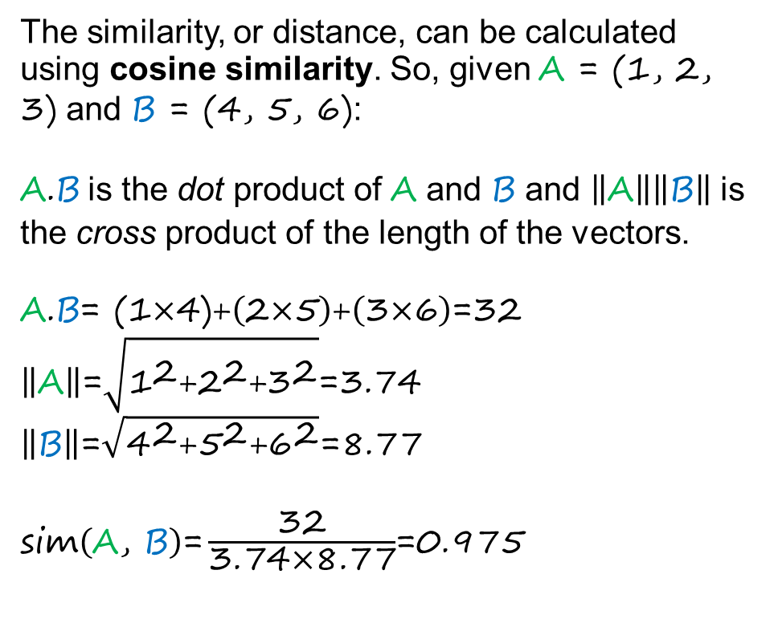
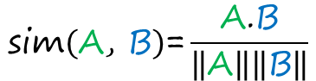
Semantic Similarity – Cosine Similarity
The similarity, or distance, can be calculated using cosine similarity. So, given A = (1, 2, 3) and B = (4, 5, 6):
$\text{A}\text{.}\text{B}$ is the dot product of A and B and $\left\|\text{A}\right\|\left\|\text{B}\right\|$ is the cross product of the length of the vectors.
$$\text{A}\text{.}\text{B}\text{= (1}\text{×}\text{4)+}\left(\text{2}\text{×}\text{5}\right)\text{+}\left(\text{3}\text{×}\text{6}\right)\text{=32}$$
$$\left\|\text{A}\right\|\text{=}\sqrt{{\text{1}}^{\text{2}}\text{+}{\text{2}}^{\text{2}}\text{+}{\text{3}}^{\text{2}}}\text{=3.74}$$
$\left\|\text{B}\right\|\text{=}\sqrt{{\text{4}}^{\text{2}}\text{+}{\text{5}}^{\text{2}}\text{+}{\text{6}}^{\text{2}}}\text{=}\text{8.}$77
$\text{sim}\left(\text{A}\text{, }\text{B}\right)\text{=}\frac{\text{32}}{\text{3.74}\text{×}\text{8.}\text{77}}$=0.975
$$\text{sim}\left(\text{A}\text{, }\text{B}\right)\text{=}\frac{\text{A}\text{.}\text{B}}{\left\|\text{A}\right\|\left\|\text{B}\right\|}$$
We looked at this idea in week 2 wrt convolutional filter weights

Slide 63
Semantic Similarity
To create a classifier using semantic similarity we can use a heuristic approach.
Start with a list(s) of words that are representative of the categories e.g. ‘good’ and ‘bad’ for sentiment.
Optionally, find other similar words within the corpus using cosine similarity.
Score each word in an input example according to its similarity to each word in the category lists.
Average the word scores to produce semantic scores for each category.
['the', 'movie', 'was', 'terrible', 'and', 'boring']
Positive score: 0.44
Negative score: 0.55

